Slide 1
Cluster Analysis
Notes:
This set needs video dividers

Slide 2
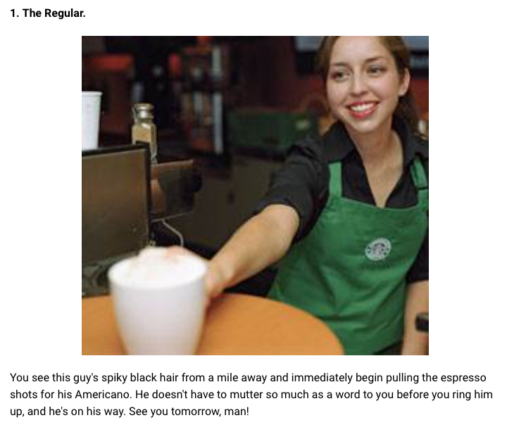
7 Types of Starbucks
Customers

Slide 3
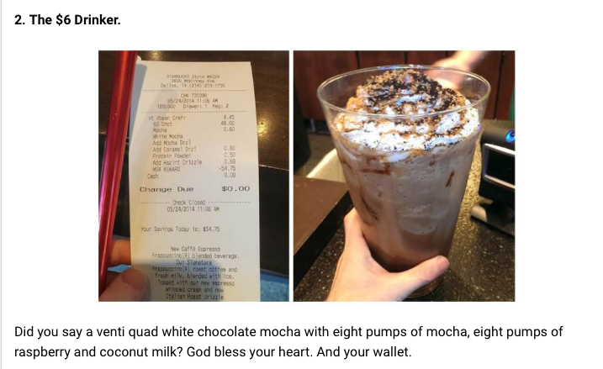
7 Types of Starbucks
Customers

Slide 4
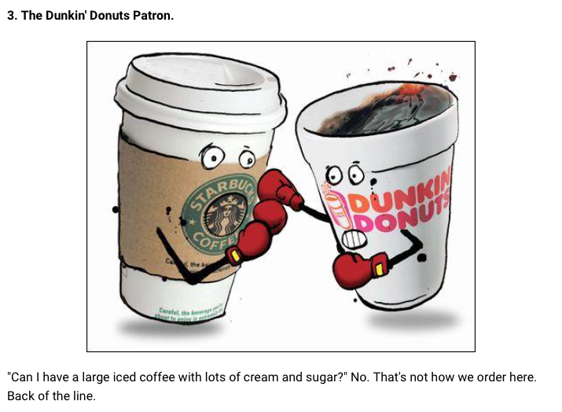
7 Types of Starbucks
Customers

Slide 5
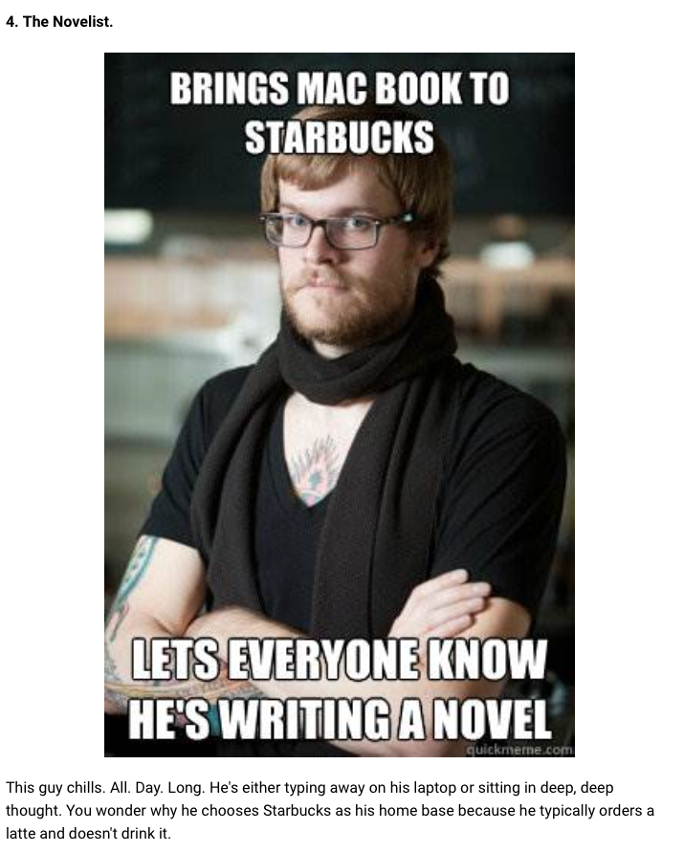
7 Types of Starbucks
Customers

Slide 6
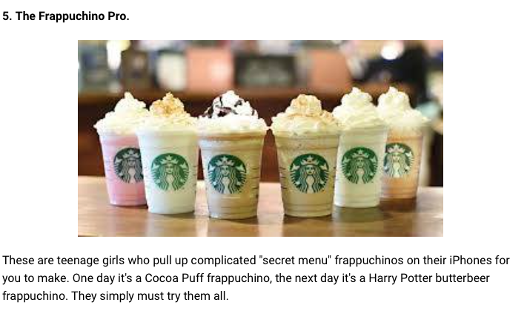
7 Types of Starbucks
Customers

Slide 7
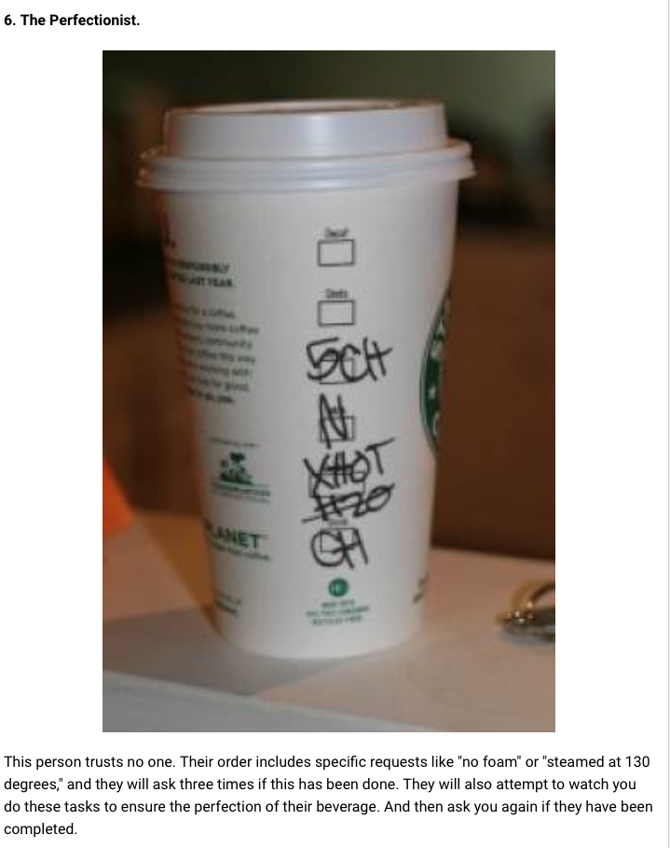
7 Types of Starbucks
Customers

Slide 8
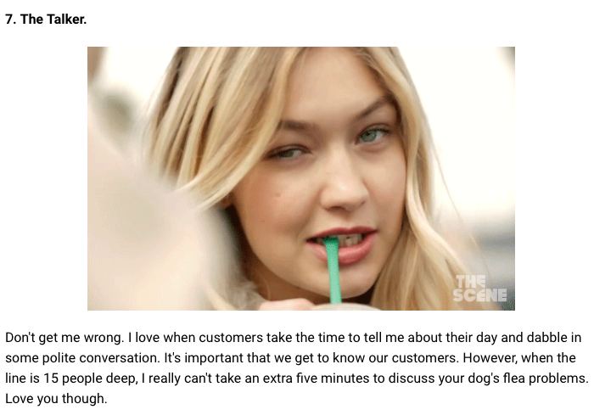
7 Types of Starbucks
Customers

Slide 9
Segmentation at Sticks Kebob

Slide 10
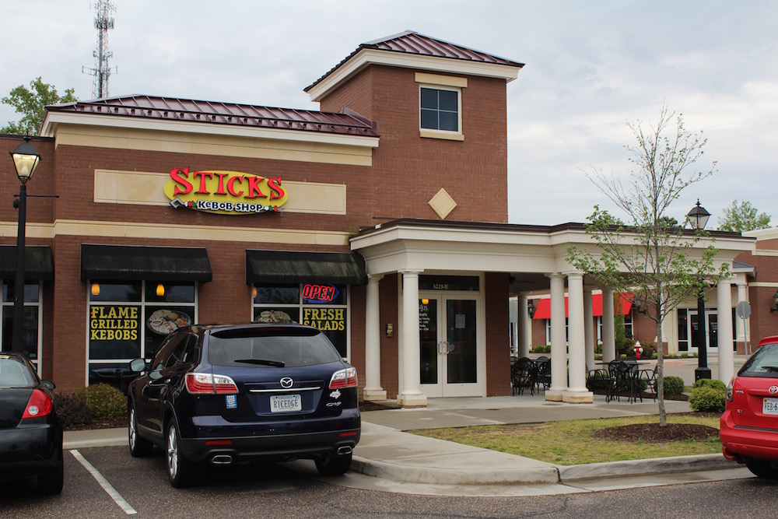

Slide 11
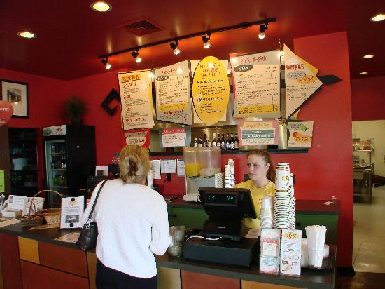

Slide 12
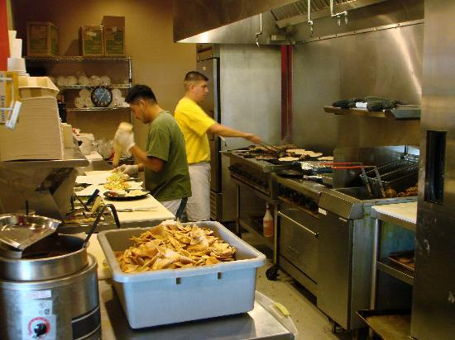

Slide 13
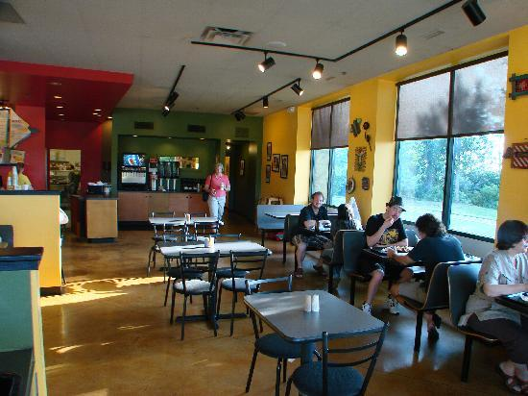

Slide 14
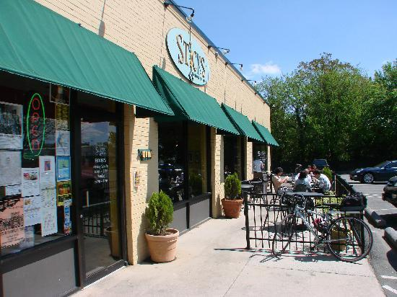

Slide 16
https://claritas360.claritas.com/mybestsegments/#zipLookup

Slide 17

Multi-Attribute Segmentation
The PRIZM® Methodology: Neighborhood Lifestyle Segmentation
“Birds of a feather flock together”
“People with similar cultural backgrounds, needs, and perspectives naturally… chose to live in neighborhoods that offer affordable advantages and compatible lifestyles.”
“These neighborhoods can be grouped into ‘clusters’ that exhibit similar demographic and behavioral characteristics. These neighborhood clusters can then be used to identify and locate marketing targets.”
http://tiny.cc/ClaritasPrizm

Slide 18
PRIZM® by Claritas
Landed Gentry
2nd City
Society
Elite
Suburbs
Urban
Uptown
T1
5.8mm HHs
C1
5.2mm HHs
S1
7.8mm HHs
U1
5.4mm HHs
High
Country
Families
Exurban
Blues
R1
5.5mm HHs
T2
5.5mm HHs
The Affluentials
S2
7.3mm HHs
2nd City
Centers
Urban
Midscale
C2
6.9mm HHs
U2
6.2mm HHs
Socioeconomic Status
Medium
Inner
Suburbs
Heartlanders
S3
5.8mm HHs
R2
3.4mm HHs
Rustic
Living
Working
Towns
R3
8.8mm HHs
T3
6.3mm HHs
2nd City Blues
Urban Cores
Low
C3
6.8mm HHs
U3
5.2mm HHs
Rural
Town
2nd City
Metro Suburb
Metro Urban
Urbanization

Slide 19

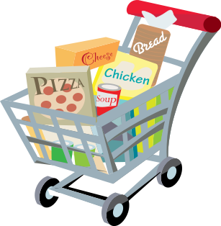




Identifying Segments: Possible Bases for Segmenting Consumers and Customers
Purchase Behavior
and Product Use
Demographics
Psychographics
Desired
Benefits/Needs
Notes:
Lifestyle, social or personality characteristics

Slide 20
Cluster Analysis
Deriving Clusters and Assessing Overall Fit
Decide on Clustering Algorithm
Many algorithms are available
More coming all the time
Main goal: maximize differences between clusters relative to variation within clusters

Slide 21
K-Means Clustering
10
10
9
9
8
8
7
7
6
6
5
5
4
Assign each objects to most similar center
Update the cluster means
4
3
3
2
2
1
1
0
0
0
1
2
3
4
5
6
7
8
9
10
0
1
2
3
4
5
6
7
8
9
10
Reassign
Reassign
K=2
Arbitrarily choose K object as initial cluster center
Update the cluster means

Slide 22
Criteria for Effective Segmentation
Identifiable?
Sustainable?
Accessible?
Actionable?
Responsive?
Notes:
Through demographics, etc.
Are the segments big enough for marketing programs to be profitable?
How to reach the segments through promotion and distribution?
Will the segmentation help develop effective marketing message?
Will they react uniquely to promotion?

Slide 23
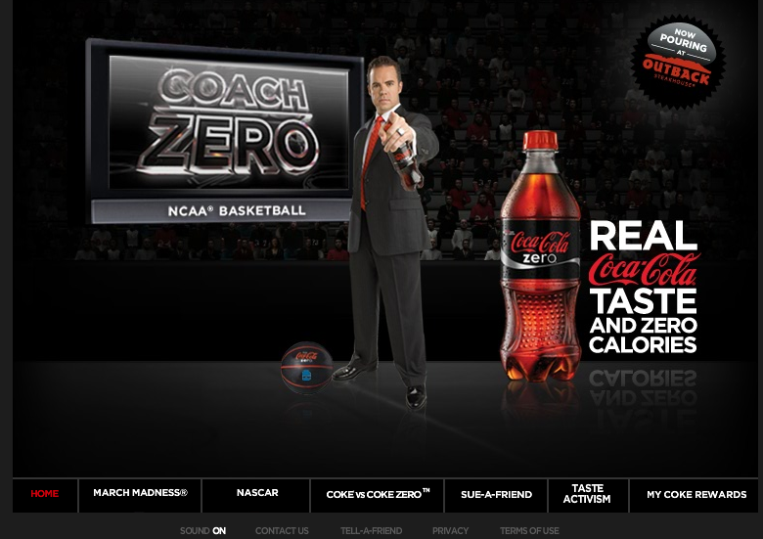

Slide 24
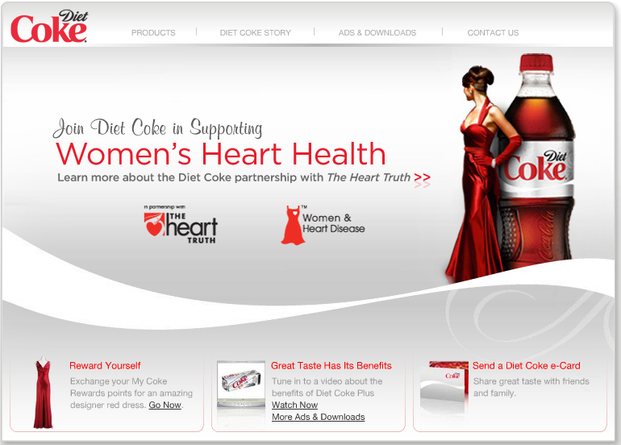

Slide 25
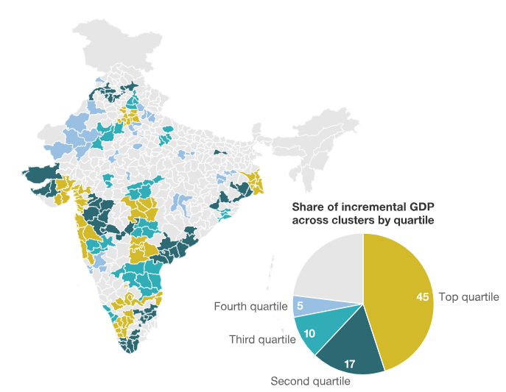
https://www.mckinsey.com/featured-insights/asia-pacific/understanding-indias-economic-geography
Notes:
Forty-nine high-potential metropolitan clusters will account for about 77 percent of India’s incremental GDP from 2012 to 2025.
183 distric = each cluster = major city plus contigius cities around it

Slide 26

When Segmentation Fails
Using same segmentation scheme for different business objectives
Different advertising or different products?
Too much focus on techniques
Using only psychographic or demographic variables
Not focusing on differences in customer needs
Static segmentation schemes
Lack of senior management buy-in

Slide 27
Steps to Implement
Identify Demographic, Psychographic Variables
Choose the variables to cluster
Describe behavior using clusters
Merge with Demographic variables to operationalize

Slide 28

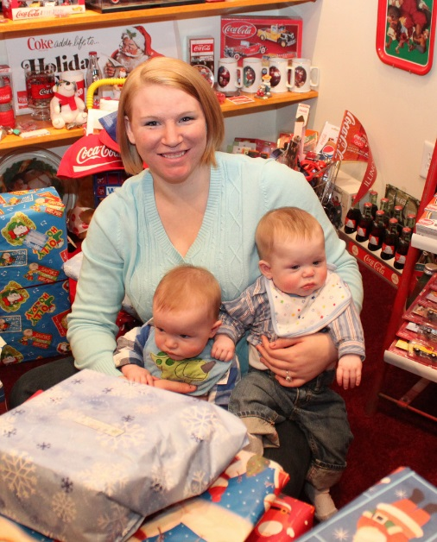



Customer Centricity at Best Buy
Barry | Jill | Helen and Charlie | Carrie | Ray
Affluent Tech Enthusiast | Busy Suburban Mom | Empty Nesters | Young Single Woman | Price-Conscious Family Guy
Image Credit Steve Jurvetson https://www.flickr.com/photos/ jurvetson/8200336388/ | Image Credit Bill & Vicki T https://www.flickr.com/photos/ iluvcocacola/15582114874/ | Image Credit Adrien Pâris https://www.flickr.com/photos/ 25146904@N06/3411097311/
Notes:
Missing two image credits?

Slide 29
A Few Bumps in the Road at Best Buy
Fortune Magazine, March 2006
…the first few dozen stores it segmented, where same-store sales grew at three times the rate of regular stores, Best Buy stepped on the accelerator
…it then tinkered ceaselessly to get the mix of products and employees just right […] Anderson and his executives assumed subsequent stores could just flip a switch and convert to centricity.
“When we gave the operating manual to the stores for the fall,” he says ruefully, “it was four inches thick.” Adds executive vice president John Walden, Anderson's point man for centricity: “The way we deployed was too confusing.”
Instead of jumping as it had in previous quarters, same-store sales growth at the renovated stores was only slightly better than the chainwide average (5.4 percent vs. 3.3 percent). The poor results persuaded him to freeze centricity rollouts for the fourth quarter. (They resumed in March.)

Slide 30
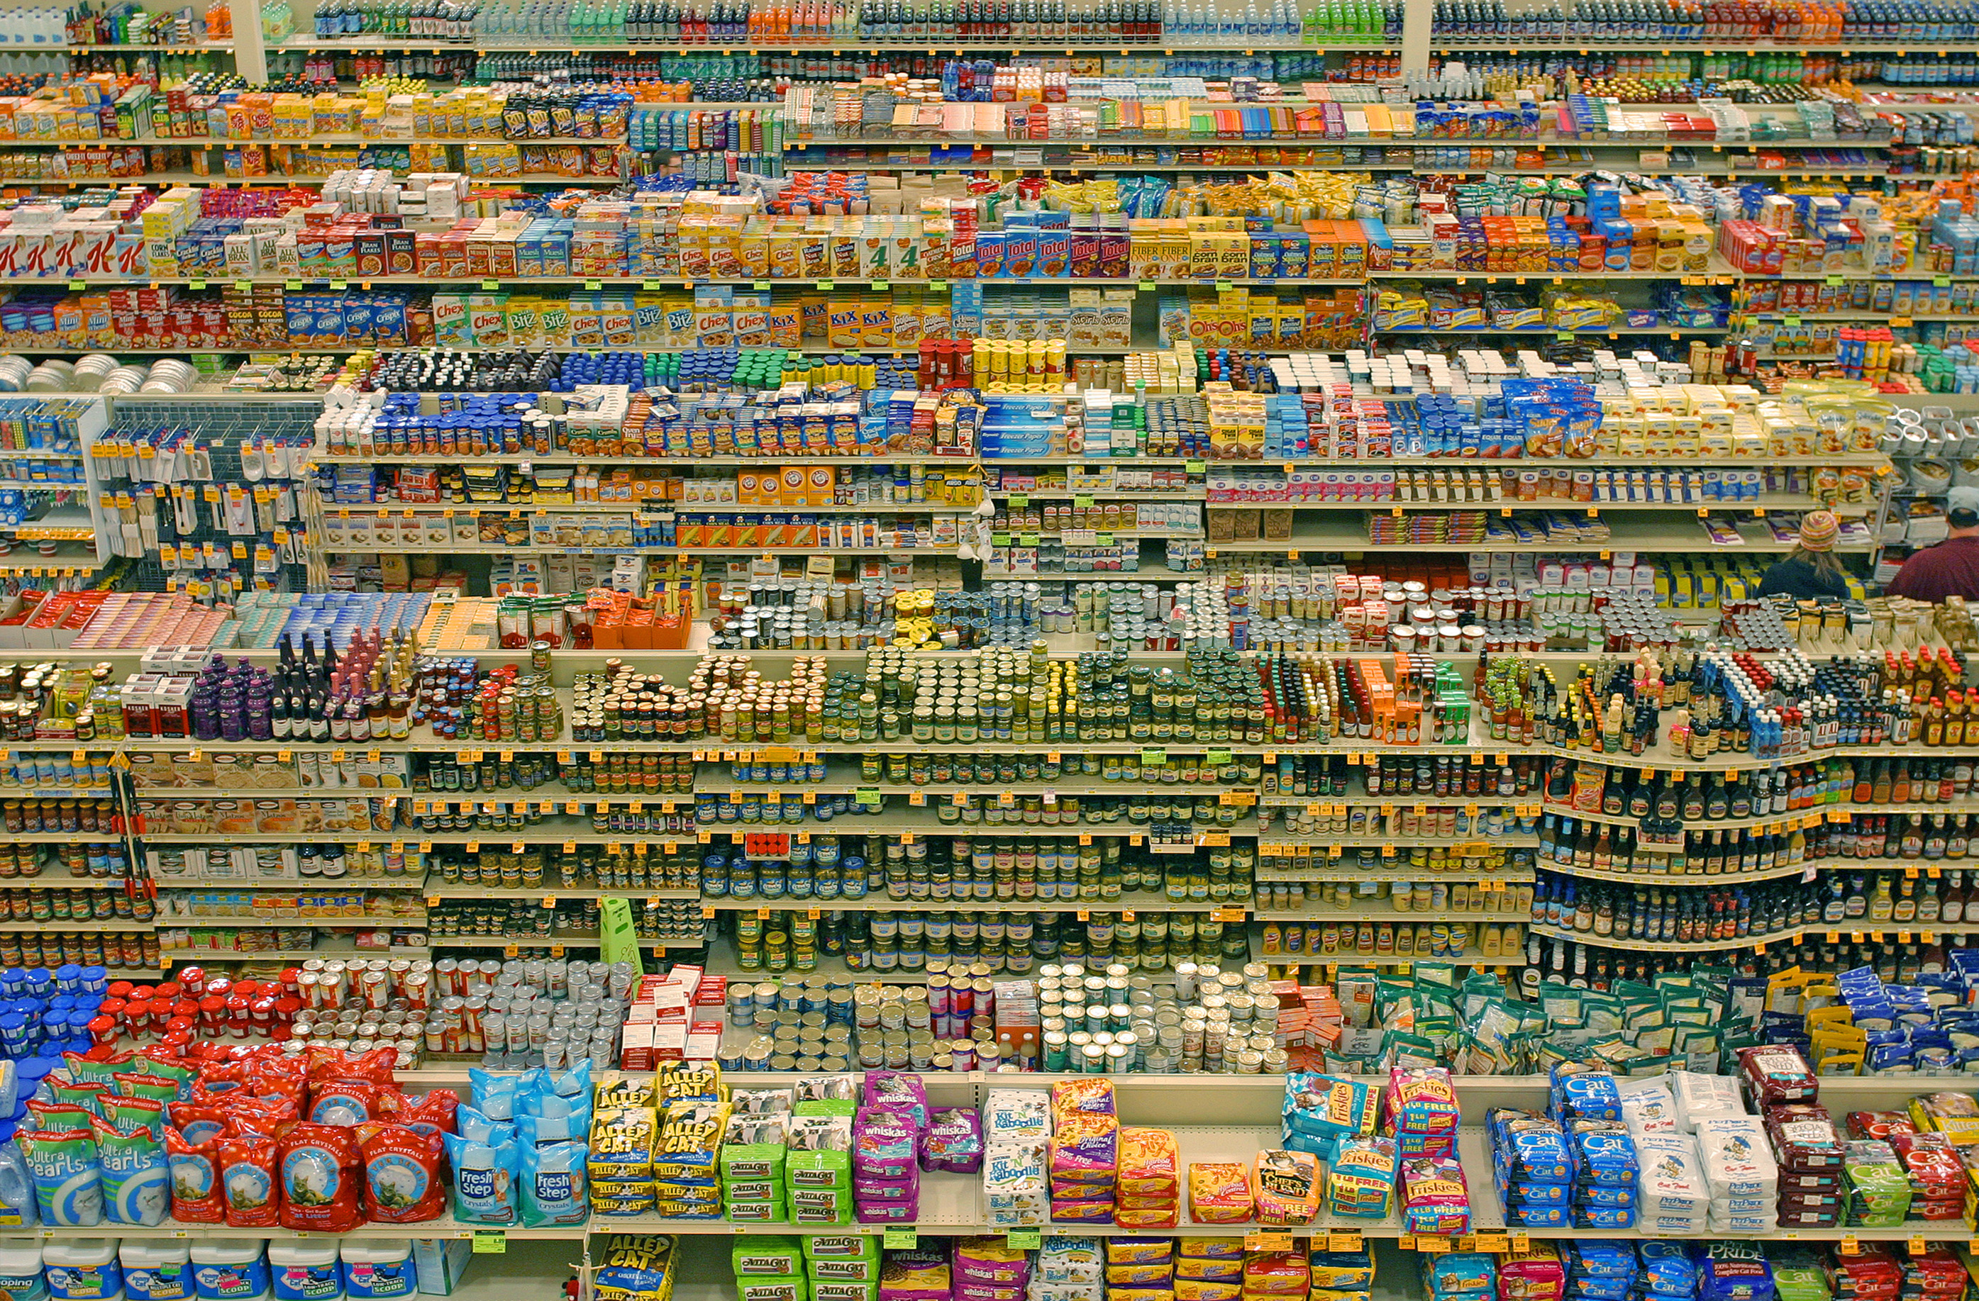

Slide 31
You are what you buy…but not everyone understands that yet
Model
AKA
Used by
Real Consumer
You are what you earn
Demographics / Social class
Mass market media buyers
I spend very differently from my “peer.”
You are where you live
Geodemo-
graphics
“Targeted” marketing industry
I can’t eat at Jane’s house:
No organics!
You are what you say you are
Lifestyle questionnaires
Many CPGs and research firms
I try to tell the truth … as best I recall it.
You are what you do
Behavior-based targeting
Some leading retailers and CPGs
OK … now you’ve got me!
To deliver on this, we look at billions of transactions from 200 million households worldwide…something no one else can do

Slide 32
Each consumer’s DNA is different
Each dimension describes a particular element of a customer’s needs and wants
Each customer has a different degree of involvement with each of these dimensions – which we capture with a dimension score
Dimension examples: High price, Low price, Asian, Baby, Big Box, Bulk, Canned, Cat, Dog, Diet, Elderly, Ethnic, Fresh, Frozen, Gourmet, Healthy, Hispanic, Home Baking, Home Cooking, Kosher, Low Carb, Meat, No time, Organic, Snacking
Notes:
Bullet slide
This will be one of the most commonly used slides.
Replace the existing text contents by highlighting and typing over.
Use the promote and demote buttons on the toolbar to change between level settings and bullets automatically
If all your information will not fit onto the slide, challenge its length or run onto two slides using the same slide title followed by: - continued.
dunnhumby story and image panel
On all slides a section has been created on the right to accommodate images and quotes. Different examples of these are shown throughout the template.
dunnhumby story and image boxes are at the end of the template, preformatted so you can copy and paste them on to your slides when appropriate.
If you are using a quote without a picture do not use a box (see Multiple bullet level slide for an example).
Information in the main section of the slide should not extend into the imagery and facts section.

Slide 33
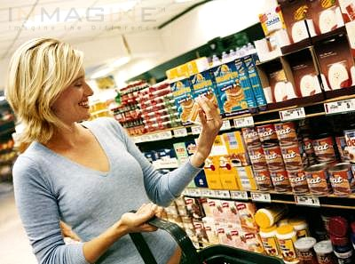
When you understand what your shopper is doing and why, it is much easier to connect
This is a friend I know, she is….
…a busy young lady
…looks after her health
…loves fresh produce
…shops on Saturday mornings
…reads People Magazine
…has a cat
…doesn’t particularly care about price
…but does look out for promotions
…pays by credit card
…only occasionally uses self-scanning
I know 50m+ people as well as I know her
Notes:
Through data, we know the customers better so we can give them more relevant information
Most agencies would crave the information
We know lots and lots of customers

Slide 34
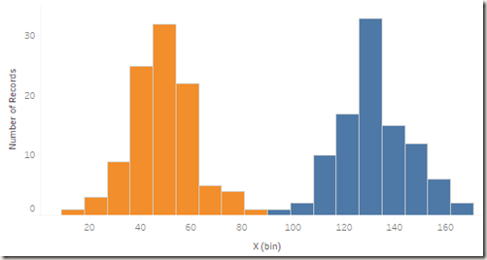
2 Groups of People – Toy Buys
Source: https://boraberan.wordpress.com/2016/07/19/understanding-clustering-in-tableau-10/

Slide 35
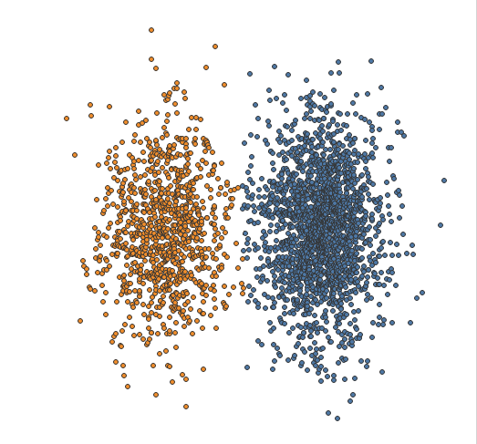
2 Groups of People Toy Buys
Source: https://boraberan.wordpress.com/2016/07/19/understanding-clustering-in-tableau-10/

Slide 36
Customer Preferences
Customer | Design | Speed
1 | 5 | 1
2 | 7 | 3
3 | 4 | 4
4 | 7 | 4
5 | 4 | 5
6 | 5 | 5
7 | 8 | 5
8 | 3 | 6
9 | 4 | 7
10 | 3 | 8
Preference on a 10-point scale, 10 most preferred and 1 least preferred for Design and Speed of a laptop

Slide 37
Customer Preferences

Slide 38
Customer Preferences

